Slide 1



Resisting Anti-rights Attacks: Inclusive Healthcare with Intersex Justice
SORCHA NÍ FHAOLÁIN • INTERSEX IRELAND / EIWH

Slide 2


QUESTION
Whose bodies are seen as worthy of care?
Not all bodies are treated as worthy.

Slide 3

Control ≠ Care
Intersex, women, trans people have been treated as errors to fix.
Control is often prioritised over consent and care.
Healthcare systems reproduce social norms rather than challenge them.

Slide 4



Intersex children & medical violence
Non-consensual surgeries and hormone treatments to make bodies appear “normal.”
Decisions made by doctors and parents, not the child.
Outcome = Abandonment
Child grows up untreated.
Doctors untrained and refuse to engage.
Older intersex people are left with no policy, no research and no services.

Slide 5



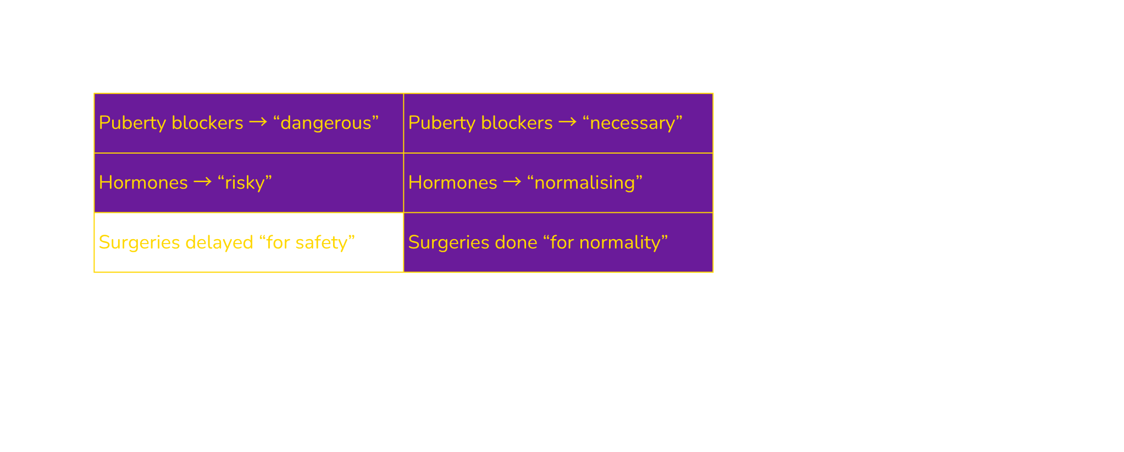
Trans access blocked.
Denied (Trans Person)
Forced (Intersex Person)
Double Standard
Political, not scientific. The issue is autonomy.

Slide 6


Invisibility kills.
Erased from medicine and data
Women’s exclusion from research has set a lasting pattern.
Medicines were dosed on the “average male body” and side effects are dismissed.
Intersex and trans people are rarely included in medical trials, research, policy data, and care.
If you’re not counted, you don’t count.

Slide 7


Abandonment after paediatrics - older intersex people “ageing in obscurity”

Slide 8


Sex Work & Health
Intersex
Exclusion
Transgender
Interlocking exclusions
Trans sex workers face major barriers: stigma, insurance, SRH, PrEP, and mental health care.
Intersex sex workers: virtually no data: a planned invisibility.
Both excluded from prevention campaigns and sexual health research.
Invisible in research = Invisible in healthcare

Slide 9


Sport = Policing
Sport as a tool of exclusion
“Protect women’s sport” → testing, exclusion, humiliation.
Rooted in racism and bigotry → policing women’s bodies.
Female athletes were subjected to “gender verification”
Chromosomes ≠ binary: XXY, XO, XXX, XYY, and more exist.
Weaponising biology to divide and police.

Slide 10

Division is a trap
LGBT
I
Separating intersex from trans feeds the far right.
Both face medicalisation, exclusion, and bodily control.
Far-right narratives exploit division to undermine solidarity.
The fights are not identical — but they are shared.
And when we are divided, we lose.

Slide 11

Avoid harmful advocacy
Avoid arguments that compare or rank suffering.
Using intersex harm to justify trans access reinforces inequality.
The principle must be clear: no medical intervention or denial without consent.

Slide 12





EIWH & Intersex Ireland
HPV-FASTER IMPLEMENT
SPIOMET4HEALTH
CBIG-SCREEN

Slide 13

Call to Action
Expose medial hypocripsy
Name medicalisation for what it is = control
Build alliances
Demand inclusion in research and policy

Slide 14
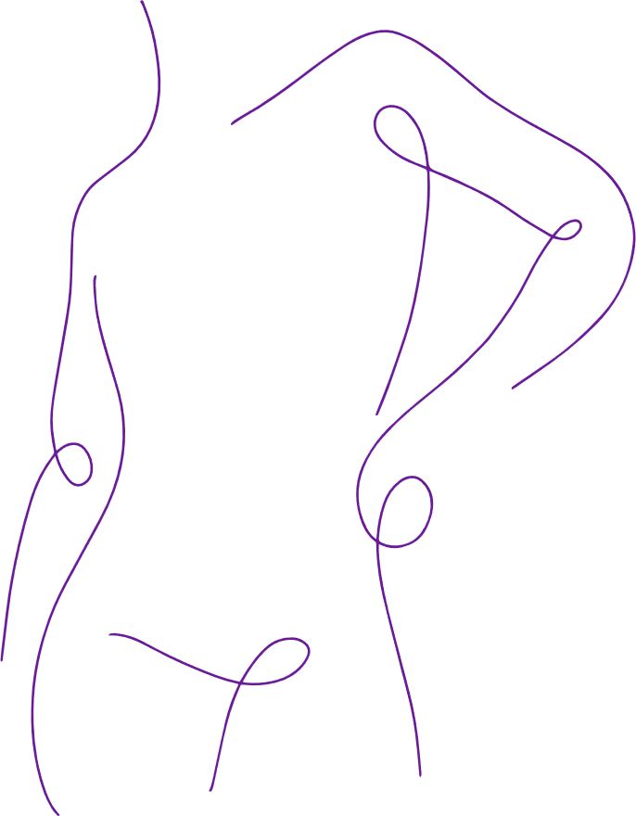
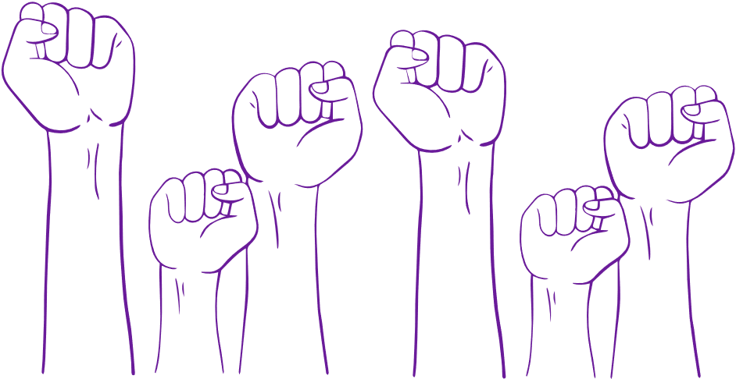
Every body counts — when we fight for it.
Intersex Ireland

